Slide 1




An Empirical Analysis of a Large-scale Mobile Cloud Storage Service
Zhenyu Li Xiaohui Wang Ningjing Huang
Mohamed Ali Kaafar Zhenhua Li Jianer Zhou
Gaogang Xie Peter Steenkiste

Slide 2






Prevalence of Personal Cloud Storage
33.1% CAGR 2016-2020: global personal cloud storage market¹
https://www.alliedmarketresearch.com/personal- cloud-market
Notes:
Last few years have witnessed the glowing popularity of personal cloud storage services. This is exemplified by the fact that Internet giants, including google, microsoft, apple and baidu, are putting great efforts to build better personal cloud storage services. Dropbox, which is also very successful, even only provides personal storage service. Indeed, it is predicted that global personal cloud storage market will be growing very fast, with a compound average growth rate of over 30 persentage.

Slide 3




Prevalence of Personal Cloud Storage
Internet
Cloud Storage
Personal data
Facts promote personal cloud storage
  User side: abundant and pervasive personal data
  Cloud side: enabling convenient share and sync of data
Notes:
The prevalence of personal cloud storage is owned to several facts. First, we see abundant and pervasive personal data that are generated each day that need to be stored remotely in the cloud in order for either backup purpose or sharing purpose. The second fact is related to the cloud side that makes the share and synchronization of data much easier.

Slide 4


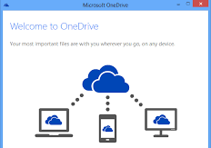
Personal Cloud Storage Meets Mobile Internet
Enabling users to access their data from everywhere
Mind the unique features, e.g.
  Not easy to perform editing
  More likely to experience low transferring performance
Notes:
Another important fact that promotes the personal cloud storage service is mobile network. When personal cloud storage meets mobile Internet, the mobile cloud storage service emerges. The mobile cloud storage service enables users to access their data from everywhere. We have seen all the major personal cloud storager services provide convinient access from smart phones or tablets, which generate millions of photos and videos every second in the world.
On the other hand, we should note that there might be some unique features of mobile cloud storage service. For instance, it is not easy to perform editing due to power and screen constraints, and we are more likely to experience low transmission performance when using mobile cloud services.
But we have very limited knowledge on the system artifacts of the mobile cloud storage service.

Slide 5
Motivation of Our Work
User QoE
Cost
Providers
User behavior pattern
How mobile users behave when accessing the cloud storage services: different from PC based users?
Performance
What are the factors that limit the storage and retrieval performance?
Notes:
This motivates our work. In particular. we study two aspects of the service: user bheaivor and data transmission performance. user behavior pattern to ask the following question: “how mobile users behave when using mobile cloud storage app? Do they behave similar to PC-based users”. We also examined the data transmission performance, with a focus on “what factors, from the system perspective, limit the storage and retrieval performance”. These two aspects shed light on the QoE improvement and Cost reduction, which constitute the two goals of cloud service providers.

Slide 6
Contributions
Analysis: based on 350 million HTTP logs from a large-scale personal cloud storage service
  We (are among the first to) characterize mobile user behavior when accessing the service
  We identify two important factors that limit TCP data transmission performance
Suggestions: we provide a bunch of recommendations for the system optimization
Dataset: we make our dataset publicly available to research community
Notes:
To this end, based on 350 million HTTP logs from a large-scale personal cloud storage service, we are among the first to …. And we have also identified two …
Based on the analysis, we provide a bunch of recommendations for the.
To facilitate the research in this area, we have made our dataset publicly available.

Slide 7





A glance at the examined service
Storage servers
Login servers
Metadata servers
HTTP logs
Chunk request:
sequence of chunks
1
file name + MD5
3
File operation:
file name
file size
file MD5
# of chunks
MD5 for chunks
2
storage
Note 1: chunk size 512KB
Note 2: No delta encoding
Note 3: HTTP
Note 4: sequential chunk requests
Notes:
Let’s first have a glance at the examined service. There are three types of servers. A user has to first login in and then interact with metadata servers and storage servers. To store a file, the client sends file name plus the MD5 hash value of the file content to the metadata servers. If no version of the file is stored,the metadata servers return the ip addresses of the storage servers. The client then initiates a file operation that sends file name, file size, the hash value and also the chunk information, including the number of chunks and the hash value for each chunk. Then the client uploads individual chunks.
There are several things we have noted. First, the chunks size 512Kbytes. Second, no delta encoding has been implemented. That is to say any change to a file that has been stored in the cloud, will result in a new file to be uploaded. Third, the data transmission is currently over HTTP. Last, within a TCP connections, chunks are uploaded sequentially.
We dumped the HTTP logs of all the storage servers for analysis in this paper.

Slide 8
A glance at the examined service
Storage servers
Login servers
Metadata servers
HTTP logs
Chunk request:
sequence of chunks
Unique URL for file MD5
3
1
File operation:
file name
file size
# of chunks
MD5 for chunks
2
retrieval
Notes:
Retrieval is the reverse process of the storage. That is the client first requests for the MD5 hash value, and then obtains the chunk information from the storage servers. Finally, the chunks flow from the storage servers to the client on the client’s requests. Also, we dump logs from the storage servers.

Slide 9

Dataset: description
HTTP-level logs from all the storage front-end servers for 1 week
  Mobile: 349 million from 1.1 million users using 1.4 million devices
  PC-based: 1.2 billion from over 2 million users
Packet-level traces from one server: 40,386 flows
user ID (annony.)
HTTP over TCP
timestamp,
Req. type (file or chunk),
data volume,
Avg. RTT
time duration to process the req.
OS type,
ID (annony.)
Notes:
Our dataset covers 1 week requests from all the storage front-end servers. For mobile, we have over 300 million logs that are generated from over 1 million users using 1.4 million devices. For comparison purpose, we also extracted over 1 billion logs from over 2 million PC-based users.
Each log contains the operating system type of the device, the Identifier after anonymization.at the client side, we also have the user idenfier, which is also anonymized. It is worth noting that one user may use multiple devices. For the connection, we have the timestamp, whether it is a file operation request, or a chunk request, the data volume carried by the connection, the average rtt of the connection. At the server side, we have the time duration to process the request, that is the time duration from when the server receives the request to the time when the server responses the request.

Slide 10
Dataset: limitations
Relatively short period (1 week)
No info of share or delete operations (only available at metadata servers)
No file or chunk information
  Grouping logs into sessions (partially solved)
Lack of packet-level traces at client side (TCP sender for storage)
  Active measurements at client side
Notes:
There some limitations of our dataset we have mention. Some of them cannot be solved. The first one is the relatively short period. We only have one-week observation period. The second one is that we have no information of share or delete operations, because they are only available at metadata servers that we have no access when collecting our dataset.
Some of the limitations can be solved at least partially. For example, we have no file or chunk information, and thus resort to group them into sessions. And we are interesting in performance analysis, but we have no packet-lelve traces at client side, which is actually the tcp sender for storage flows. We solve it through active measurements at client side.

Slide 11
Session Identification
interval τ
Logs from a device
…
…
…
session: if τ > T
file storage/retrieval operation (user’s activity)
chunk requests (non user’s activity)
Notes:
Let’s first loot at the session identification. A session here contains the activies a user does before idle for a period of time. For a device, we see a train of logs sorted by the timestamp of the logs. Note that we have two types of operations. File operations correspond to users’activies, but chunk requests do not. So we measure all the intervals between each pair of adjacent file operations. And we say an interval seperates two sessions if the interval is larger than a threshold T.

Slide 12
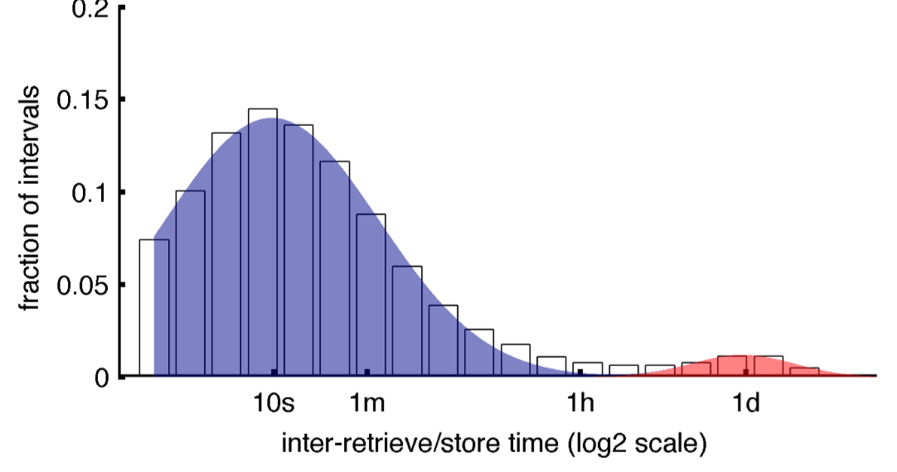
Session Identification
PDF of the τ
τ > T = 1 hour
Mixture of Gaussians with two clusters
  Intra-session intervals: mean of 10s
  Inter-session intervals: mean of 1 day
Notes:
We derive T from the dataset. To this end, we examine the distribution of the intervals from all users. We see that the distribution can be well fit with mixture of Gaussians with two clusters. The first one corresponds to intra-session intervals with mean of 10 seconds, and the second cluster corresponds to the inter-session intervals with mean of 1 day. And we find a sweet point around 1 hour that falls the two clusters with almost similar probability. So we use 1 hour as the threshold to separate sessions.

Slide 13
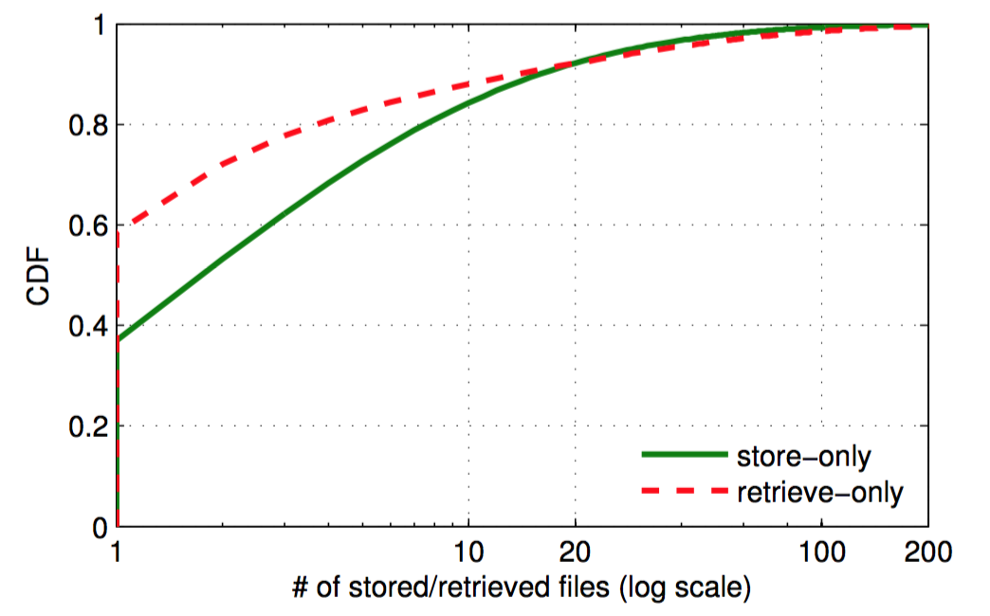
Session Characteristics
Storage-only | Retrieval-only | mix
68% | 30% | 2%
# of files transferred in a session
Notes:
Applying our session identification methodology, we find that majority of the sessions are storage-only, meaning that users only store files. Surprisingly, only 2% are for both storage and retrieval. This is an indication of the write-dominated property of the examined service.
Indeed, most of the sessions only store or retrieve 1 files. But some store or retrieve over 20, even 100 files in a single session, due to the synchronization of multiple files between clients and servers.

Slide 14
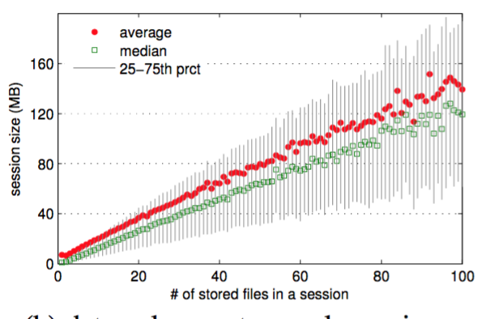
Storage-only session size (in bytes)
Linearly correlated to the number of stored files: slope 1.5MB
Notes:
We then examine How much data volume that a session carries when we vary the number of files in the session. The linear correlation between the number or stored files and the data volume of a session is very obvious here. The slope of the linear line is about 1.5MB, very closely to a typical photo size that is taken on mobile phones.

Slide 15
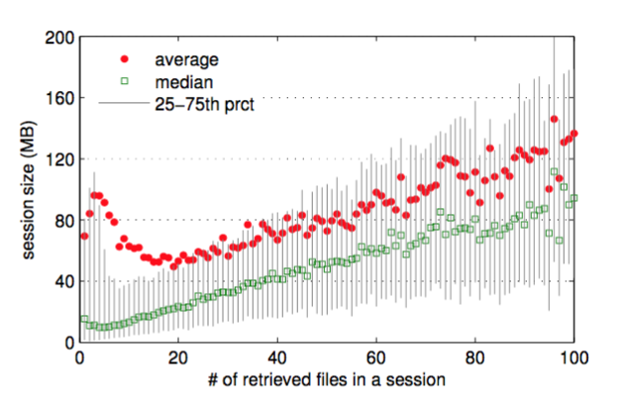
Retrieval-only session size (in bytes)
Complex correlation when < 10 files (most of sessions)
  Larger file size
Notes:
So how about retrieve sessions. Looking at the average, we see a more complex correlation here, especially when there are fewer than 10 file operations in the sessions. One thing we can infer is that the users tend to download larger files than the stored files.

Slide 16
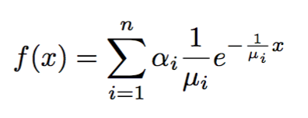

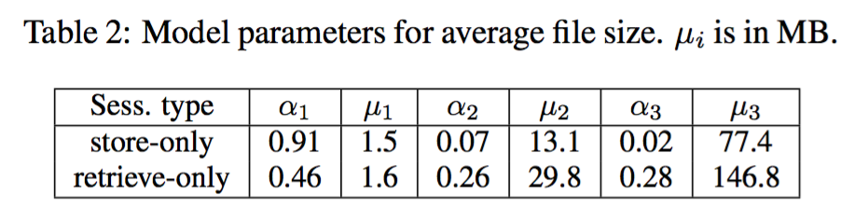
Modeling average file size
Average file size = session data volume / # of files
Mixture-exponential distribution
  Heavy-tailed distribution + mixture of several file types
weight of the the i-th component
mean of file size for the i-th component
0.91
0.46
0.28
MByte
Notes:
The above observations motivate us to look at the average file size of individual sessions. we use mixture of exponential distributions to model the average file size. We use it because of two observations. First, the average file size follows heavy-tailed distribution, which can be captured by the mixture exponential distribution. The second reason is the mixture of several file types in the service, including photos and video clips taken by mobile phones and others. Each component of the mixture exponential distribution can capture one of the typical file type, including the weight of the file type and the average size of the file type.
What we observe is that 90% of the store only sessions transfer file size of one point 5 mega bytes files that seem to correspond to photos. But less than half of retrieve only sessions do this. In contrast, we see about 30% of retrieve-only sessions retrieve file about 150 mega bytes that seem to correspond to long video clips. In fact one of the usage of the examined service is that users share some video clips, like movies, tv shows, to others through urls.

Slide 17
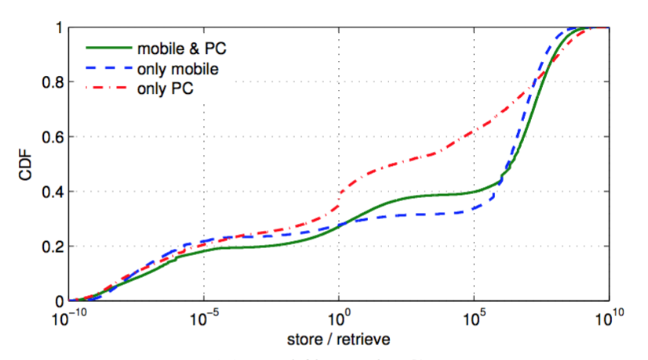
Individuals’ Usage Patterns
Storage or retrieval dominates (in data volume) at individual user level?
impact of devices
mixed
Only
download
Only upload
Storage vol. / retrieval vol.of each user
Notes:
Let’s then move to individual users’ usage patterns to see whether storage or retrieval dominated at invidual users level. So we compute the ratio of the storage data volume to the retrieval volumes of each user. We also consider the impact of device types. Three typical usage patterns are very clear here: only perform downloading, only perform upload and the mixed usage. For mobile users, 60% of them are only doing upload. When we consider pc-based users, we see the impact of the device type. Generally, we see more mixed usage pattern for PC-based users, meaning that pc users like to synchronize data in both directions.

Slide 18
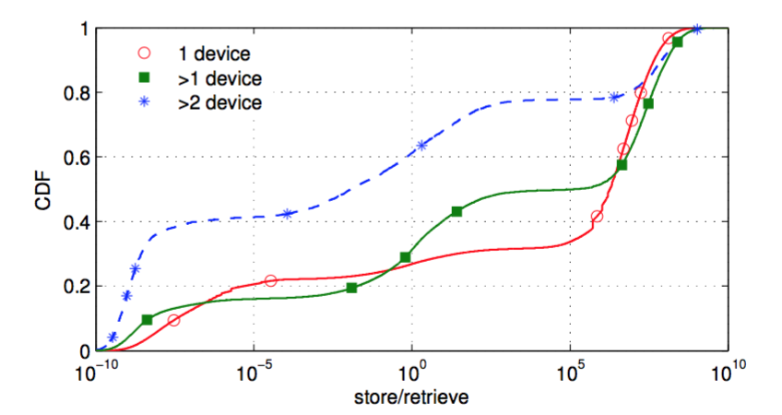
Individuals’ Usage Patterns
mixed
Only
download
Only upload
mobile users only
Storage vol. / retrieval vol.of each user
Large impact of the number of used mobile devices per user
  80% use only 1 device during the observation period
Notes:
The number of used mobile devices per user also affects the usage pattern, although over 80% of users in our dataset only use one device. Basically, users that leverage on multiple devices are more likely to be classified as download-only users, which is probably owned to the data synchronization between multiple devices.

Slide 19
Summary of User Behavior
Major Observations |  | Implications
Session type | 68% storage-only sessions | Write-dominated vs. read-dominated in Dropbox [IMC2012], U1 [IMC2015]
Session size | very few files (e.g., 1) in most of sessions | Very low possibility of bundling multiple files [IMC2013]
File size | dominated by files of 1.5 MB (photos) | Data compression and delta encoding are not necessary
Usage pattern | >50% upload-only mobile users | Used for backing up data
Notes:
We summarize the analysis of user behavior from sever perspectives. First, for session type, we find most of them are only used for storing file. This indicates the write-dominated feature of the mobile cloud storage service, which is different from what have been reported for dropbox and ubuntu one. For the session size, since only very few files in most of sessions, meaning the very low possibility of bundling multiple files as proposed in previous studies. For file size, we observe the service is dominated by files of one and half Mega bytes in size, which seem to be photos, which indicates that data compression and delta encoding are not necessary in this context. Finally, more than half of the mobile users are interested only in uploading data. It seems they are used the service only for backing up data.

Slide 20
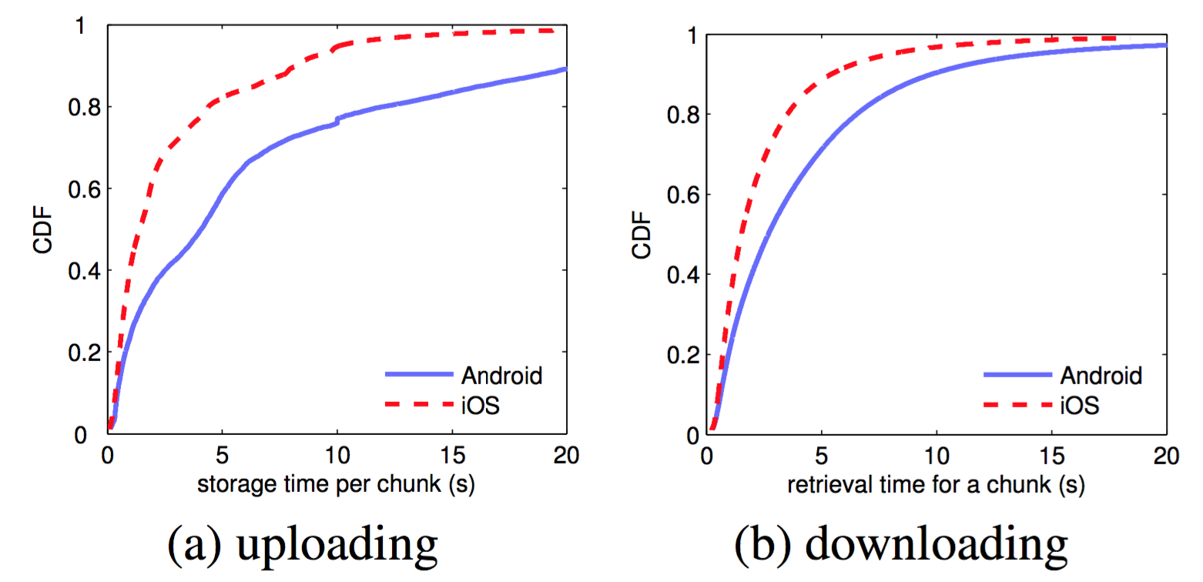
Data Transmission Performance
Time used to transmit a chunk (512KB)
What makes the difference?
Notes:
Let’s then have a quick look at the data transmission performance. We measured the time used to transmit a chunk that is half mega betys. What is surprising here is the large performance gap between the android devices and ios devices. So we move to figure our the reasons behind.

Slide 21
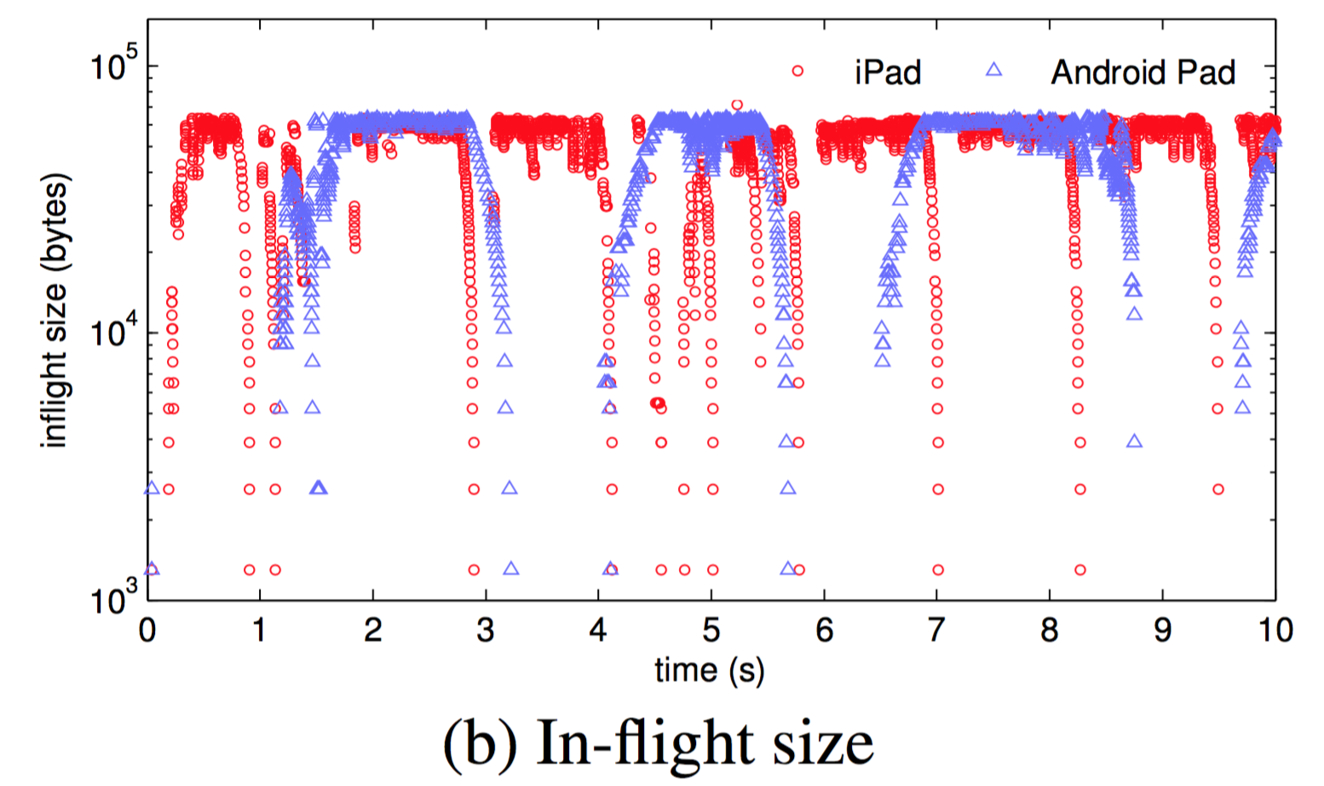
TCP Inflight Size Analysis
--a storage flow
limited at 64KB
log scale
Sequential chunk requests and transferring
Larger idle time between Android pad leads higher possibility to trigger slow start after idle (SSAI)
Notes:
Let’s first have a look of one particular storage flow. Here we show the TCP inflight size over time. We know that the inflight size is a good indicator for the data transmission performance. We have two interesting oberservations. First, we can clearly see the sequential chunk requests and transferring. But this is not the problem itself. The problem is the large intervals between two chunks, especially for android flows, may trigger the tcp slow start after idle.
Another surprising observation is the limit on the inflight size at 64 kilo bytes.

Slide 22
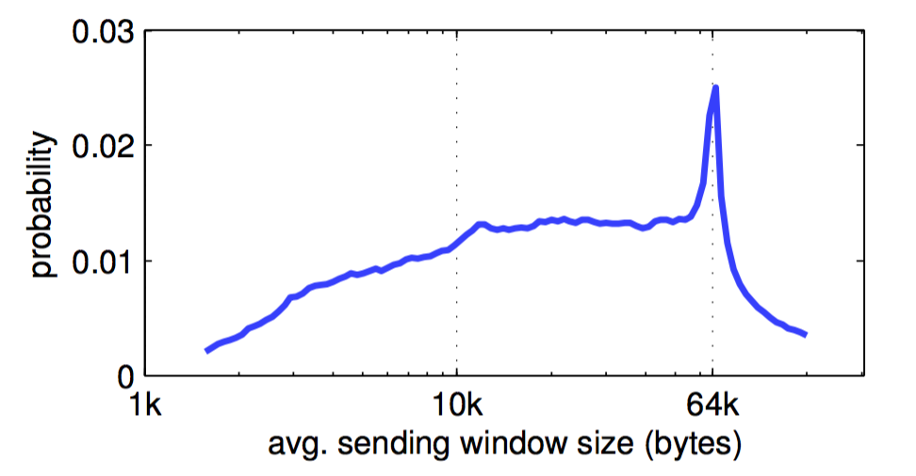
Sending Window Estimation
swnd_est = throughput * avg_RTT
Servers advertise 64KB rwnd with window scaling option disabled
Notes:
This can be confirmed from our trace. Here is the probability distribution of the estimated sending window size. We can see the concentration at 64 kilo bytes. We can confirm that this limit comes from the server side with window scaling option disabled.
This is indeed caused by the limit on at the server side on the advertised receiver window size

Slide 23
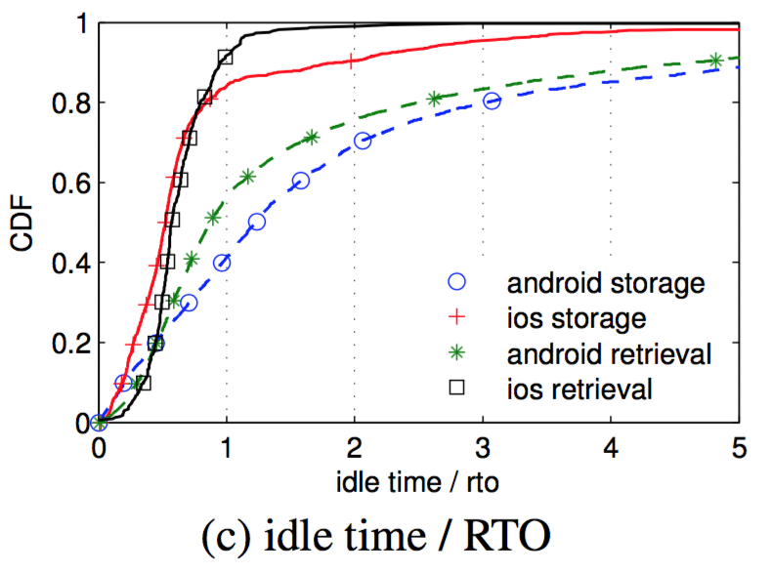
SSAI: slow start after idle
SSAI: restart of TCP slow start after an idle duration larger than RTO
50% of Android intervals vs. 18% of iOS intevals
Notes:
Let’s then have a look at the second possible constraint, that is the SSAI. According to the TCP implementation, SSAI will be triggered if the TCP connection sees no data over one RTO. We show the cdf of the ratio of intervals to the RTO. If the ratio is larger than 1, SSAI will be triggered. The observation is that over half of the intervals between two chunks, in either storage or retrieval flows, will lead to the trigger of SSAI. But this percentage is only 18% for iOS flows.
This partially explains the performance gap between android and iOS flows.

Slide 24
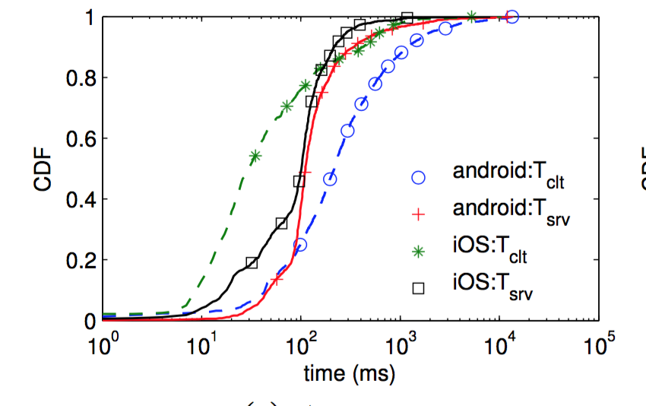
Who contributes most to the idle time?
Client side or server side?
It’s the (Android) client side !
Notes:
Then we want to know who contributes most to the idle time. The idle time may be caused either by the client side or the server side. So we want to know is the client side contributes most or server side. Here is the CDF of idle time breakdown by the client and server side. We see that the server side almost spends the same time for the two types of devices. But the android clients spend far more time than the server side. We thus conclude that it’s the client side that contributes moss.

Slide 25
Solutions for Performance Improvement
Servers: enabling TCP window scaling option
  Risk: increased bandwidth requirement
Clients & servers: disabling SSAI
  Risk: burst after idle that leads to high packet drop rate
Client: processing fast to reduce idle period
Larger chunk size (e.g., 1.5 MB): reducing the number of idle periods
Notes:
Several solutions can be used for performance improvement. First, servers can enable TCP window scaling operation to mitigate the first limit. The corresponding risk is the increased bandwidth demand. For the second performance limit factor, the SSAI, we can simply disable SSAI in the implentaion. The risk is that we may see lots of burst traffic after idle which can lead to packets drop.
on the other hand, since client contributes most to the idle time, we can expedite the processing at client side. An easier way is the increase the chunks size to 1.5 Mega bytes or even larger, in order to reduce the number of idle periods.

Slide 26
Another Takeaway: what is the mobile cloud storage service?
A backup service, or a file hosting service?
  due to the upload-dominated usage pattern at both session and user level
We need
  Longer observation period
  Logs of share and delete operations
We hope our dataset also helps
  http://fi.ict.ac.cn/data/cloud.html

Slide 27
Thanks

Slide 28
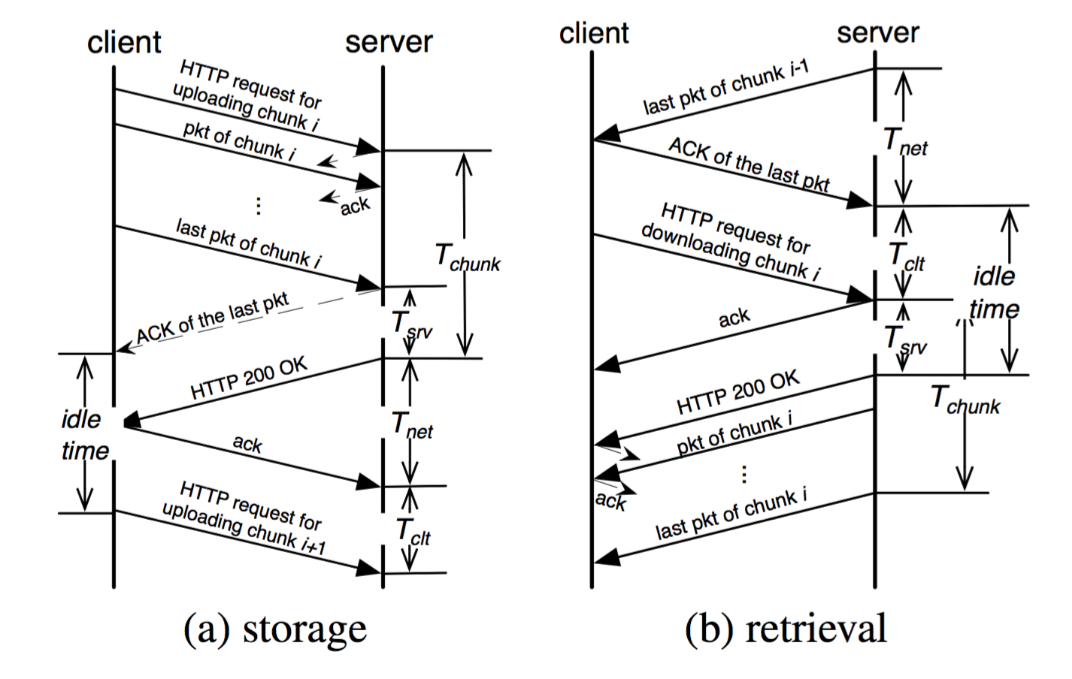
Backup

